Slide 1


CSE 591 Geographic Analysis
Ross Maciejewski
rmacieje@asu.edu

Slide 2
Spatial Statistics
Tobler’s first law of geography¹ – “everything is related to everything else, but near things are more related than distant things”
Spatial dependency is the co-variation of properties within a geo-space
If correlation exists (either positively or negatively), there are at least three possible explanations:
There is a simple spatial correlation relationship (whatever is causing an observation in one location also causes similar observations in another)
Spatial causality (something at a given location directly influence nearby characteristics)
Spatial interaction (movements through this area cause this relationship)
1 – W. Tobler. A computer movie simulating urban growth in the Detroit region. Economic Geography, 46(2):234-240, 1970.

Slide 3
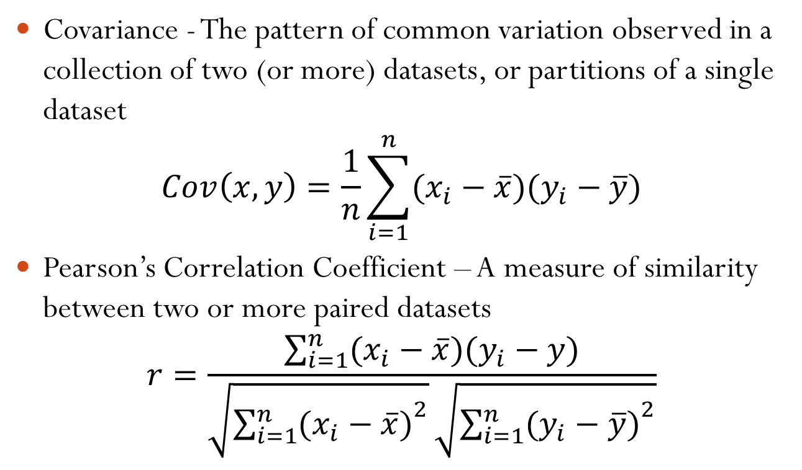
Statistical Measures
Covariance - The pattern of common variation observed in a collection of two (or more) datasets, or partitions of a single dataset
$$Cov\left(x,y\right)=\frac{1}{n}\sum_{i=1}^{n}{(x_{i}−\overline{x})(y_{i}−\overline{y})}$$
Pearson’s Correlation Coefficient – A measure of similarity between two or more paired datasets
$$r=\frac{\sum_{i=1}^{n}{(x_{i}−\overline{x})(y_{i}−y)}}{\sqrt{{\sum_{i=1}^{n}{(x_{i}−\overline{x})}}^{2}}\sqrt{{\sum_{i=1}^{n}{(y_{i}−\overline{y})}}^{2}}}$$
MJ de Smith, MF Goodchild and PA Longley. Geospatial Analysis: A Comprehensive Guide to Principles, Techniques and Software Tools, 2007

Slide 4
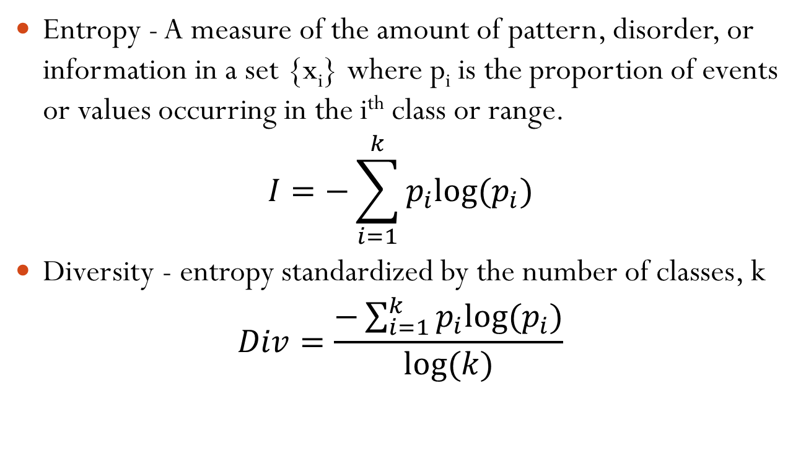
Statistical Measures
Entropy - A measure of the amount of pattern, disorder, or information in a set {x_{i}} where p_{i} is the proportion of events or values occurring in the i^{th} class or range.
$$I=−\sum_{i=1}^{k}{p_{i}log⁡(p_{i})}$$
Diversity - entropy standardized by the number of classes, k
$$Div=\frac{−\sum_{i=1}^{k}{p_{i}log⁡(p_{i})}}{log⁡(k)}$$
MJ de Smith, MF Goodchild and PA Longley. Geospatial Analysis: A Comprehensive Guide to Principles, Techniques and Software Tools, 2007

Slide 5
Spatial Statistics
For spatial data, we want to find related regions
Choropleth maps let us visually identify regions that appear to be related
But, we can do analysis prior to the visualization to find areas that are statistically correlated and focus the visual representation on these areas!
One method of doing this is using spatial autocorrelation

Slide 6
Issues in Spatial Statistics
Scaling – ensure that the conclusion of the analysis does not depend on arbitrary scaling
Sampling – determining a limited number of locations for faithfully measuring phenomena that are subject to dependency and heterogeneity
Dependency suggests that since one location can predict the value of another, we do not need observations in both places
Heterogeneity suggests that this relationship can change across space
Locational Fallacy – error due to particular spatial characterization
Ecological Fallacy – errors due to performing analysis on aggregate data

Slide 7
Distance and Direction
Knowledge of location also allows the analyst to determine the distance and direction between objects
Many types of spatial analysis require the calculation of a table or matrix expressing the relative proximity of pairs of places (often denoted by a spatial weights matrix W)
Elements of Matrix W:
1 if the places share a common boundary, else 0
The length of any common boundary between places, else 0
A decreasing function of the distance between the places, or between their representative points
MJ de Smith, MF Goodchild and PA Longley. Geospatial Analysis: A Comprehensive Guide to Principles, Techniques and Software Tools, 2007

Slide 8
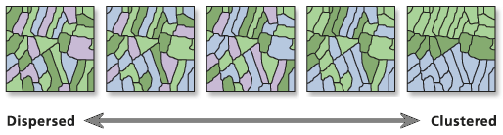
Spatial Autocorrelation
Earlier we discussed correlation, this is typically thought of in time series, discussing how related they are
We can extend this notion to space, hence Spatial Autocorrelation

Slide 9
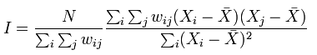
Moran’s I¹
Given a set of features and an associated attribute, Global Moran’s I evaluates whether the pattern expressed is clustered, dispersed or random
Values near +1.0 indicate clustering while values near -1.0 indicate dispersion
Global Moran’s I function also calculates a Z score value that indicates whether we can reject the null hypothesis of “there is no spatial clustering”
1 – P. A. P. Moran. Notes on continuous stochastic phenomena. Biometrika, 37:17-33, 1950.

Slide 10
What is a Z Score¹
Most statistical tests begin by identifying a null hypothesis
The Z score is a measure of standard deviations (i.e. a Z score of +2.5 means +2.5 standard deviations away from the mean)
The Z score is associated with a normal distribution
Critical Z score values when using a 95% confidence level are -1.96 and +1.96 standard deviations.
1 – R. J. Larsen and M. L. Marx. An Introduction to Mathematical Statistics and Its Applications, 2000.

Slide 11
Calculating Moran’s I
y
X | Y | Z
1 | 2 | 4.55
1 | 3 | 5.54
2 | 1 | 2.24
2 | 2 | -5.15
2 | 3 | 9.02
3 | 1 | 3.1
3 | 2 | -4.39
3 | 3 | -2.09
4 | 2 | .46
4 | 3 | -3.06
4.55
5.54
x
2.24
-5.15
9.02
3.1
-4.39
-2.09
.46
-3.06
MJ de Smith, MF Goodchild and PA Longley. Geospatial Analysis: A Comprehensive Guide to Principles, Techniques and Software Tools, 2007

Slide 12
Adjacency Matrix
y
 | 1 | 2 | 3 | 4 | 5 | 6 | 7 | 8 | 9 | 10
1 | 0 | 1 | 0 | 1 | 0 | 0 | 0 | 0 | 0 | 0
2 | 1 | 0 | 0 | 0 | 1 | 0 | 0 | 0 | 0 | 0
3 | 0 | 0 | 0 | 1 | 0 | 1 | 0 | 0 | 0 | 0
4 | 1 | 0 | 1 | 0 | 1 | 0 | 1 | 0 | 0 | 0
5 | 0 | 1 | 0 | 1 | 0 | 0 | 0 | 1 | 0 | 0
6 | 0 | 0 | 1 | 0 | 0 | 0 | 1 | 0 | 0 | 0
7 | 0 | 0 | 0 | 1 | 0 | 1 | 0 | 1 | 1 | 0
8 | 0 | 0 | 0 | 0 | 1 | 0 | 1 | 0 | 0 | 1
9 | 0 | 0 | 0 | 0 | 0 | 0 | 1 | 0 | 0 | 1
10 | 0 | 0 | 0 | 0 | 0 | 0 | 0 | 1 | 1 | 0
1
4.55
2
5.54
x
3
2.24
4
-5.15
5
9.02
6
3.1
7
-4.39
8
-2.09
9
.46
10
-3.06
MJ de Smith, MF Goodchild and PA Longley. Geospatial Analysis: A Comprehensive Guide to Principles, Techniques and Software Tools, 2007

Slide 13
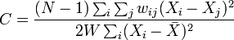
Geary’s C
Value of Geary’s C lies between 0 and 2
Values of 1 means no spatial autocorrelation
Smaller than one means positive spatial autocorrelation
Larger than one means negative spatial autocorrelation
Geary’s C is more sensitive to local spatial autocorrelation
Geary, R. C. (1954). "The Contiguity Ratio and Statistical Mapping". The Incorporated Statistician (The Incorporated Statistician) 5 (3): 115–145

Slide 14
Local Indicators of Spatial Association
Moran’s I is a global measure of correlation
We can take the individual components (or local indicators) can map and test them for significance to provide an indication of clustering patterns within the study region
See GeoDa package for implementations of LISA and Moran’s I functions
Anselin, L. (1995). "Local indicators of spatial association – LISA". Geographical Analysis, 27, 93-115.

Slide 15
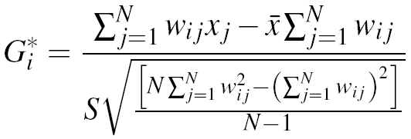
Getis-Ord Statistic²⁵
Unlike Moran’s I, the Getis and Ord statistic identifies the degree to which high or low values cluster together
where N is the number of spatial units
w_{ij} is an indicator function
x_{j} is the value at location j
x is the mean of all values
S is the standard deviation
i is the current location
25 – Aldstadt, J. and A. Getis. Using AMOEBA to Create a Spatial Weights Matrix and Identify Spatial Clusters. Geographical Analysis , 38: 327-343, 2006.

Slide 16
Significance Tests for Autocorrelation Indices
Autocorrelation coefficients can be tested for statistical significance under two different model assumptions
Classical statistical assumption of Normality
Assume that values are independent and identically distributed drawings from a Normal distribution
Observed pattern of a set of values is assumed to be just one realization from all possible random permutations
Utilizes Monte Carlo testing
MJ de Smith, MF Goodchild and PA Longley. Geospatial Analysis: A Comprehensive Guide to Principles, Techniques and Software Tools, 2007

Slide 17
Scan Statistics¹
The idea is to exhaustively scan the search space to check for all possible statistically significant clusters
For each case and control, the algorithm iteratively draws circles containing more and more data samples until the largest circle contains N/2 samples.
- control
- case
1 – M. Kulldorff. http://www.satscan.org

Slide 18
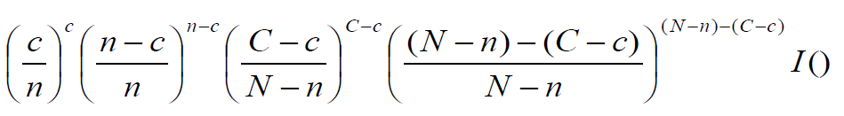
Scan Statistics
For each circle (window) compute the likelihood function
For Bernoulli distributions, the function is:
c is the number of cases in the window, C is the total number of cases in the data set, n is the number of cases + controls in the window, N is the total number of cases + controls, I() is an indicator function that is one if the number of cases is more then expected based on the null hypothesis and zero otherwise

Slide 19
Scan Statistics
L₀
- control
- case

Slide 20
Scan Statistics
L₀
- control
- case

Slide 21
Scan Statistics
[L₀]
L₁
- control
- case

Slide 22
Scan Statistics
[L₀, L₁]
L₂
- control
- case

Slide 23
Scan Statistics
[L₀, L₁, L₂, …, L_{M}]
[L₀, L₁, L₂, …, L_{M-1}]
[L₅, L₂, L₈₈, L₀, …, L_{M-22}]
P_value = (Sorted position of L0 in list)/M
L_{M}
- control
- case

Slide 24
Scan Statistics
Keeping the window in the same location, randomly redistribute the cases and controls
Calculate the likelihood function for the new distribution
Repeat 99, 999, xxx times and determine a p-value for the original distribution by sorting the likelihood functions
Related work includes the Geographical Analysis Machine¹
1 – S. Openshaw, M. Charlton, C. Wymer and A. Craft. A mark I geographical analysis machine for the automated analysis of point data sets. International Journal of Geographical Information Systems, 1:335-358, 1987.
* - http://www.ccg.leeds.ac.uk/software/gam/

Slide 25
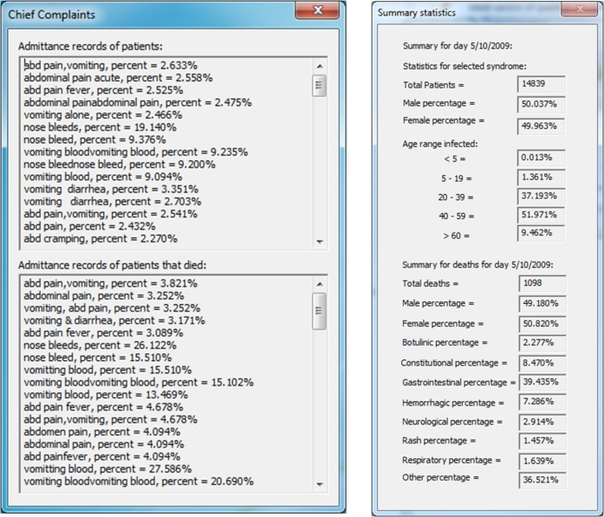
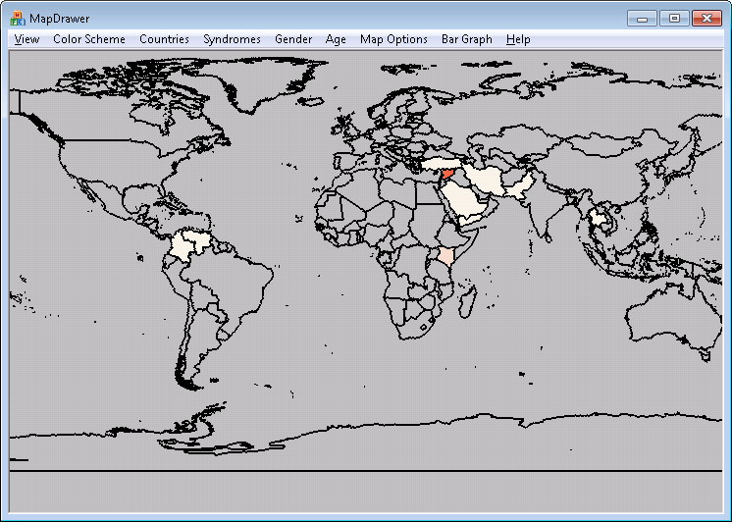
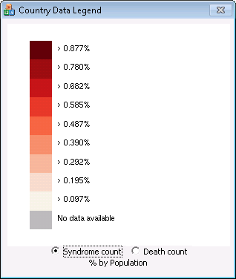
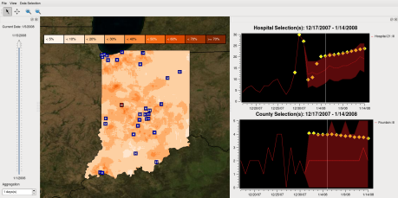
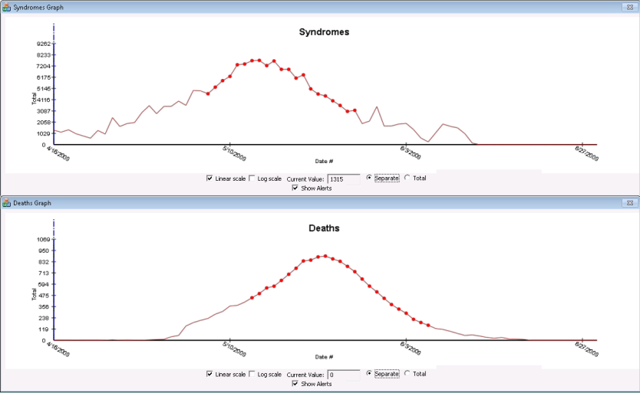
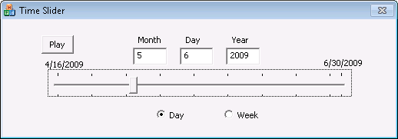
Examples in Geographic Visualization
Syndromic surveillance is the detection of adverse health events focusing on pre-diagnosis information to improve response time
Patient ID | Date | Chief Complaints | Location
9398 | 4/16/09 | Ear pain | Karachi
10816 | 4/16/09 | Stuffy nose | Lebanon
1491 | 4/16/09 | Fever | Allepo
16237 | 4/16/09 | Head bleed | Yemen
CoCo
Classifier
VAST 2010 Challenge Award: Support for Future Detection, IEEE Conference on Visual Analytics Science and Technology, October 2010 for “VACCINATED,” (Malik, A., Afzal, S., Hodgess, E., Ebert, D., Maciejewski, R.).

Slide 26
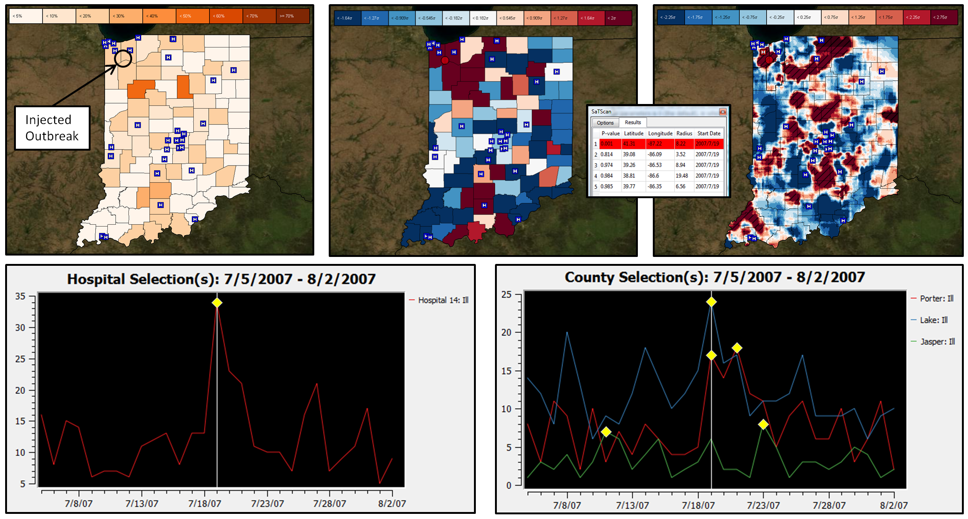

Slide 27
Time Series Modeling
Seasonal-Trend Decomposition Based on Loess
Time series can be viewed as the sum of multiple trend components
For each data signal, components are extracted
Can then analyze correlation between components
Hafen, R., Anderson, D., Cleveland, W., Maciejewski, R., Ebert, D., Abusalah, A., Yakout, M., Ouzzani, M., Grannis, S., “STL for Modeling, Visualizing, and Monitoring Disease Counts,” BMC Medical Informatics and Decision Making, 9(21), 2009.

Slide 28
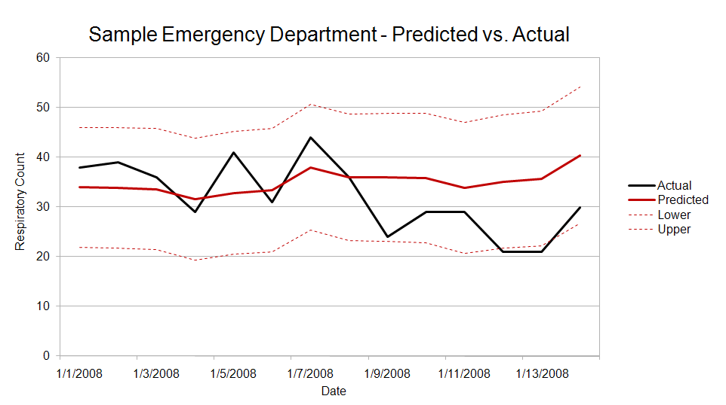
Predictive Visual Analytics

Slide 29

Predictive Visual Analytics
Maciejewski, R., Rudolph, S., Hafen, R., Mitchell, M. A., Larew, S. G., Cleveland, W., Ebert, D., “Forecasting Hotspot – A Predictive Analytics Approach,” IEEE Transactions on Visualization and Computer Graphics, 17(4): 440-453, 2011.

Slide 30
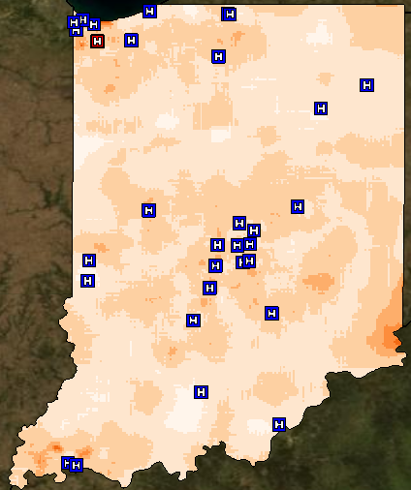
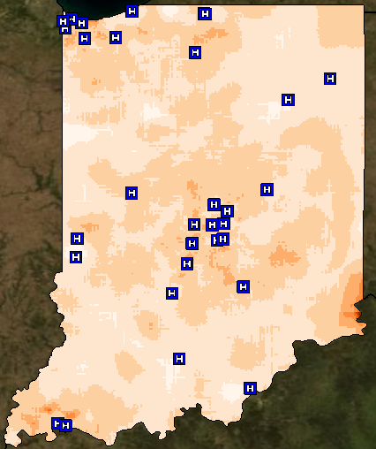
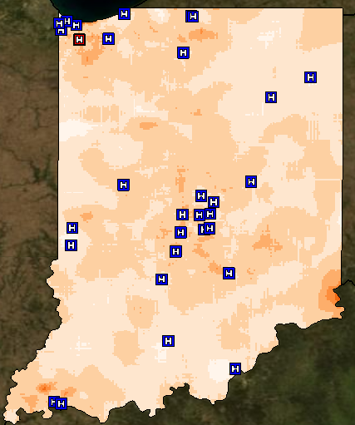
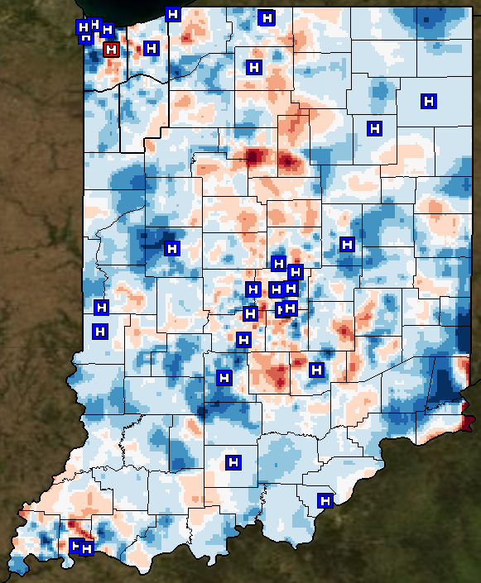
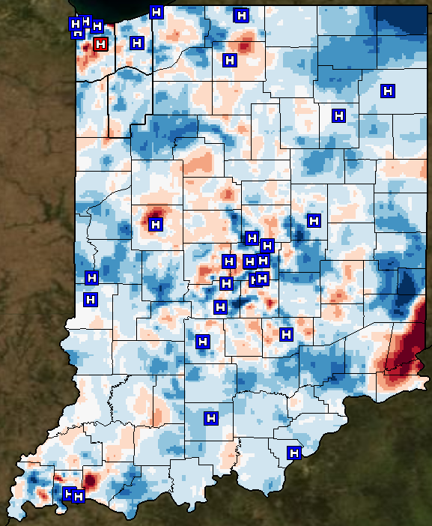
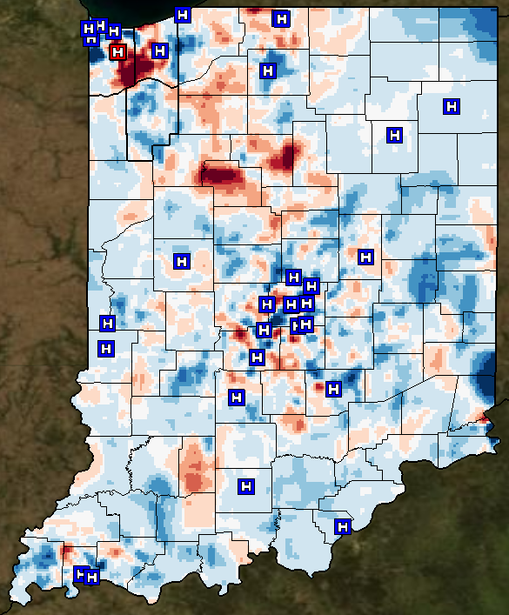
7-17-2007
7-18-2007
7-19-2007

Slide 31
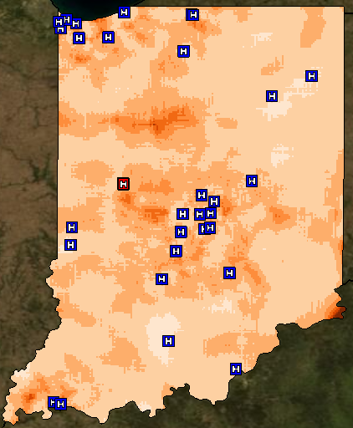

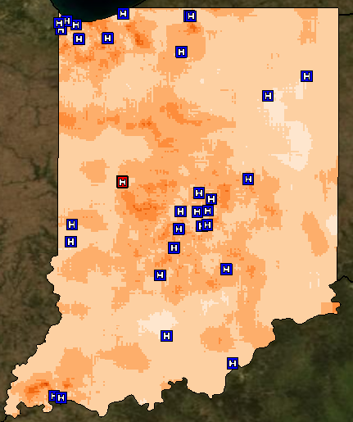
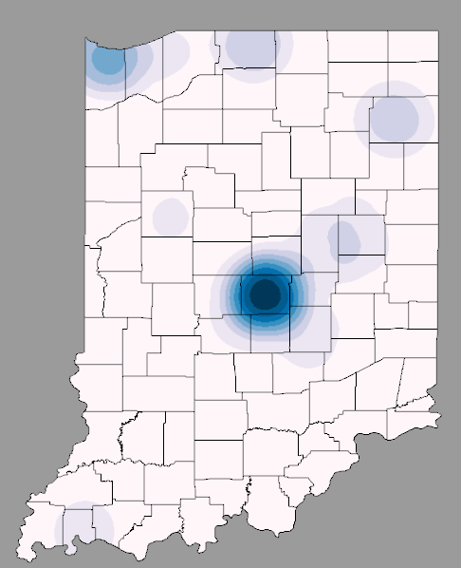
Spatiotemporal Prediction
We can guess the probability distribution of tomorrow based on past probability distributions
Day: t-3
Day: t-2
Day: t-1
Expected Distribution using all past records

Slide 32
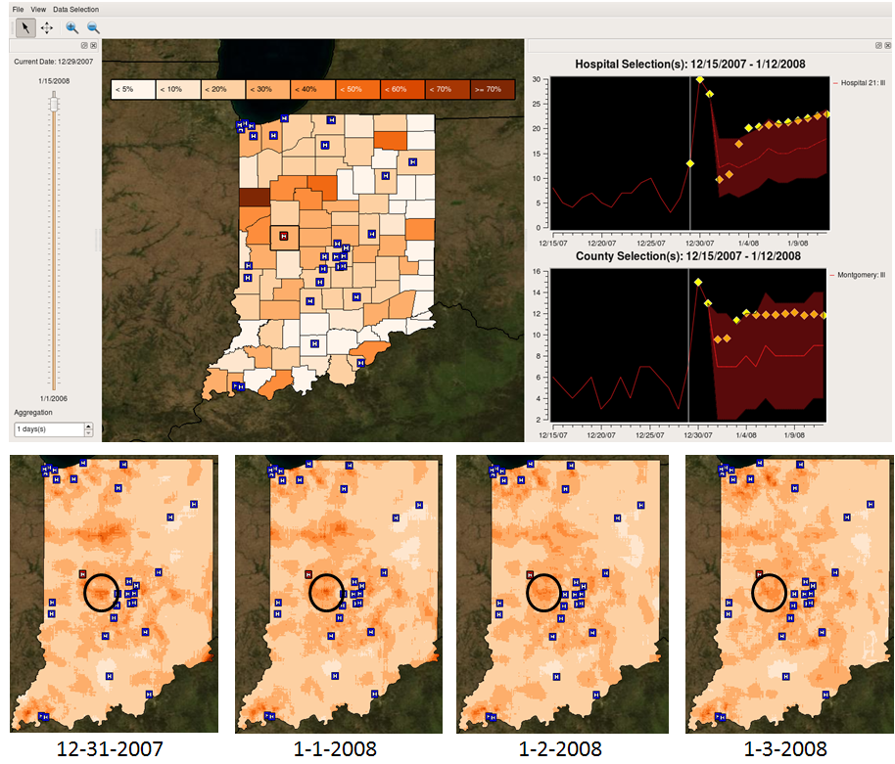

Slide 33
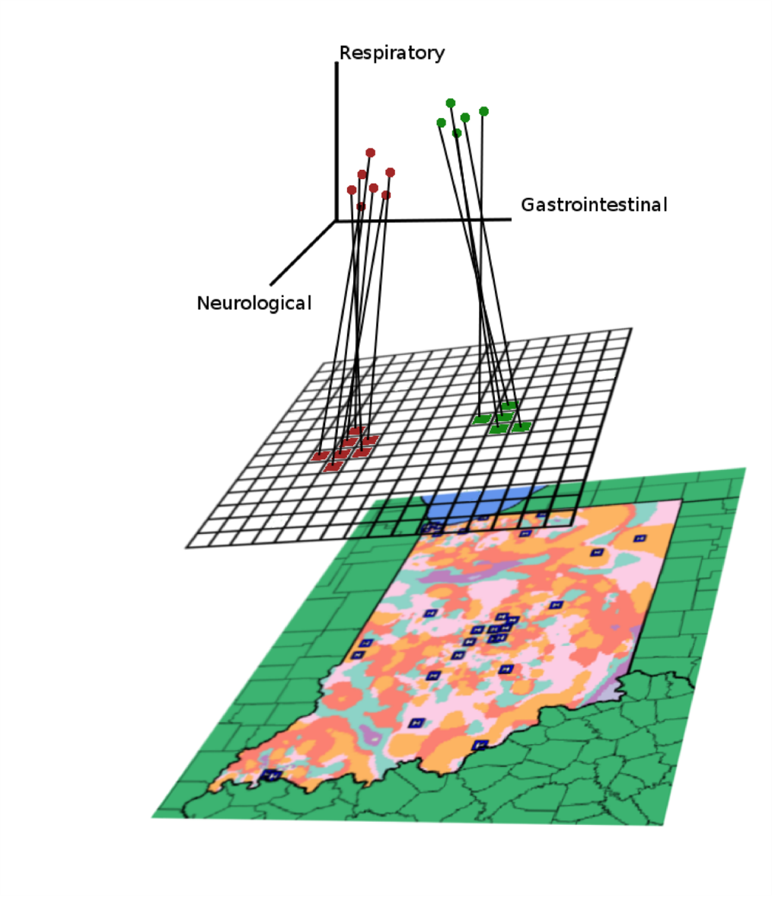
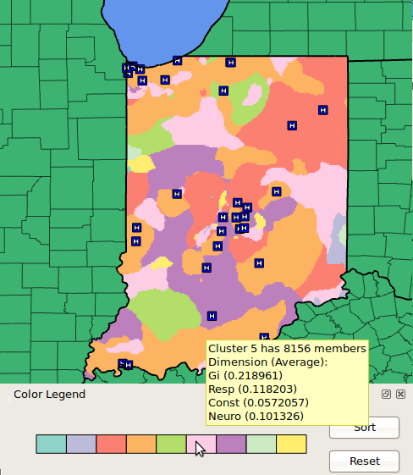
Multi-dimensional Clustering and Projection

Slide 34
Crime Mapping
The problem is analogous to syndromic surveillance
Instead of patient addresses, we now have criminal incident reports
More data (who, what, when, where, how)

Slide 35
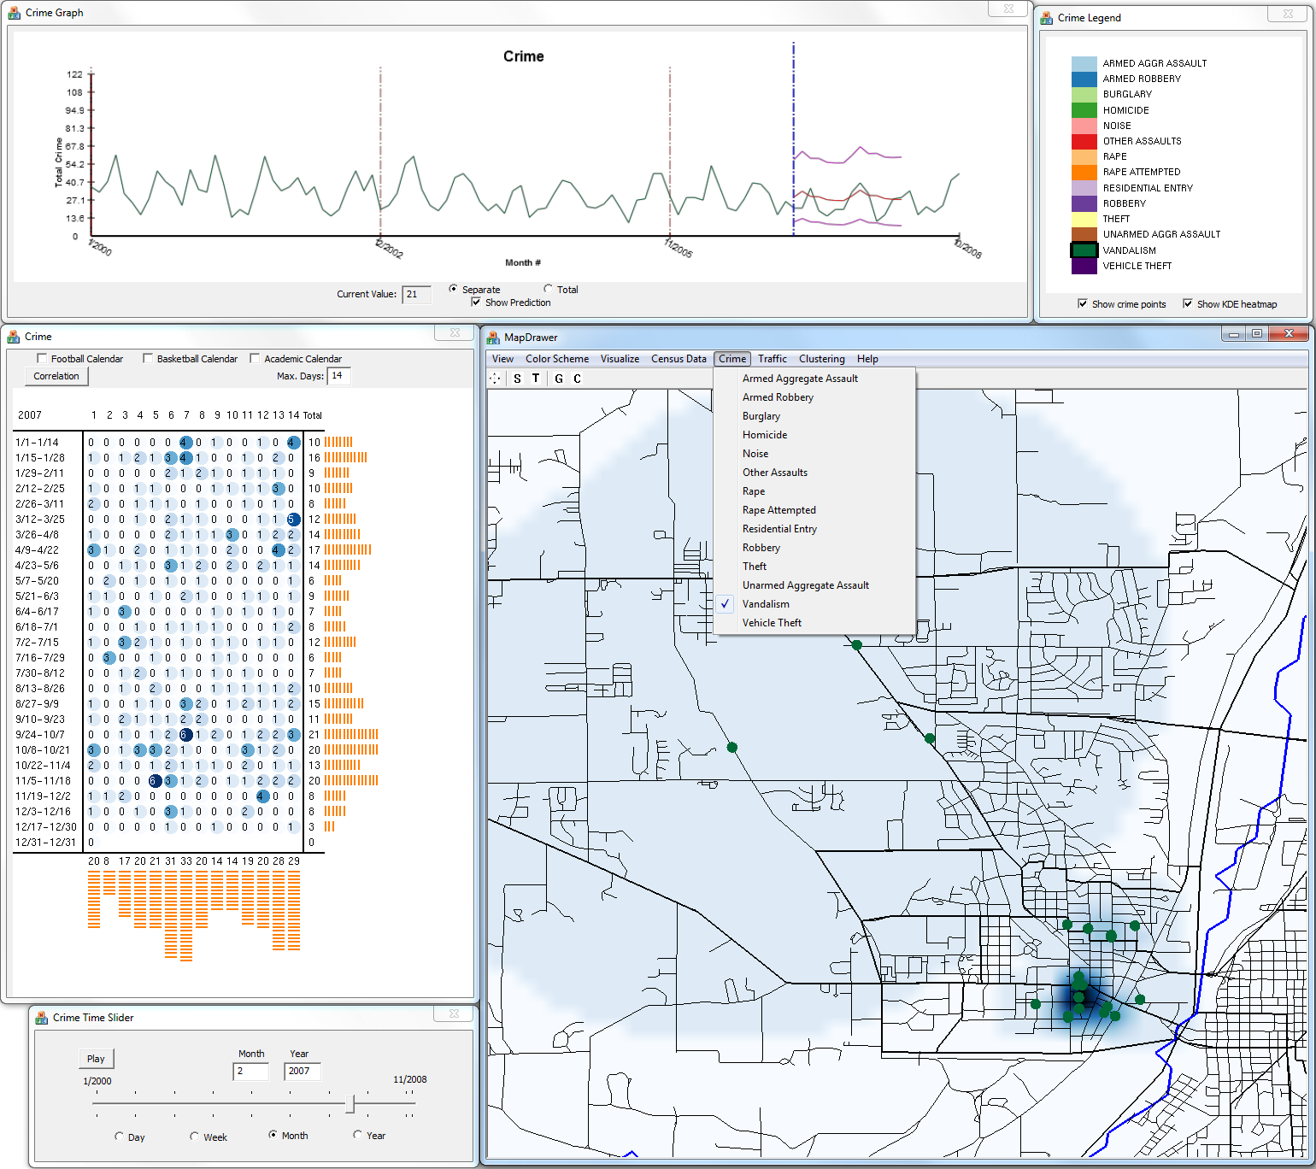
Visual Analytics Law Enforcement Technology (VALET)
Abish Malik, Ross Maciejewski, Timothy F. Collins and David S. Ebert. Visual Analytics Law Enforcement Toolkit. IEEE International Conference on Technologies for Homeland Security, 2010.

Slide 36
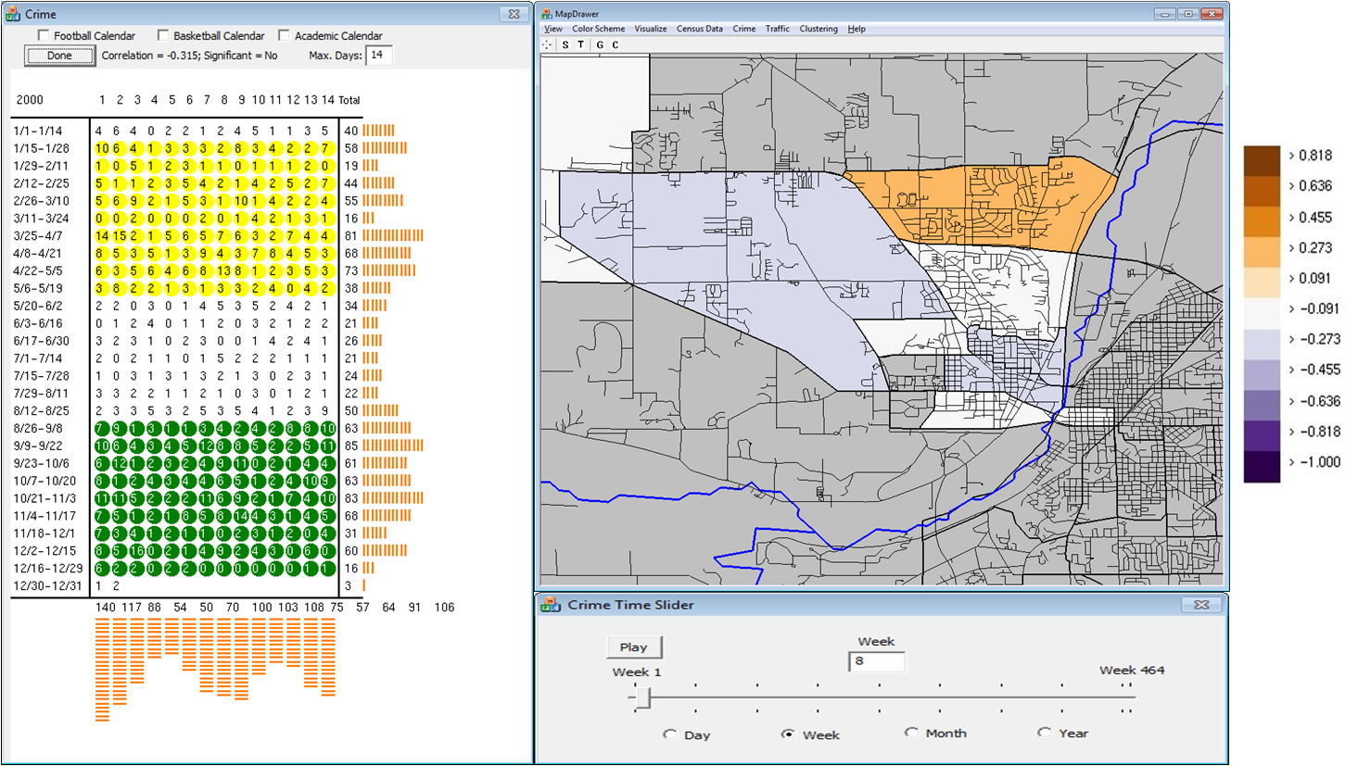
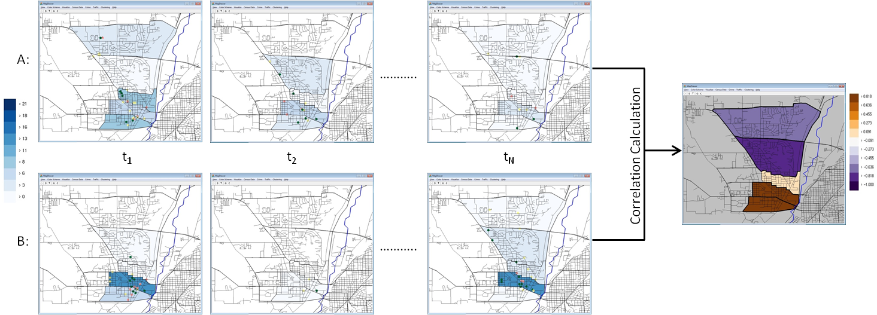
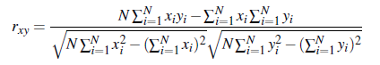
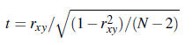
Exploring Temporal Correlations Spatially
Pearson’s Correlation Coefficient
t-Test

Slide 37
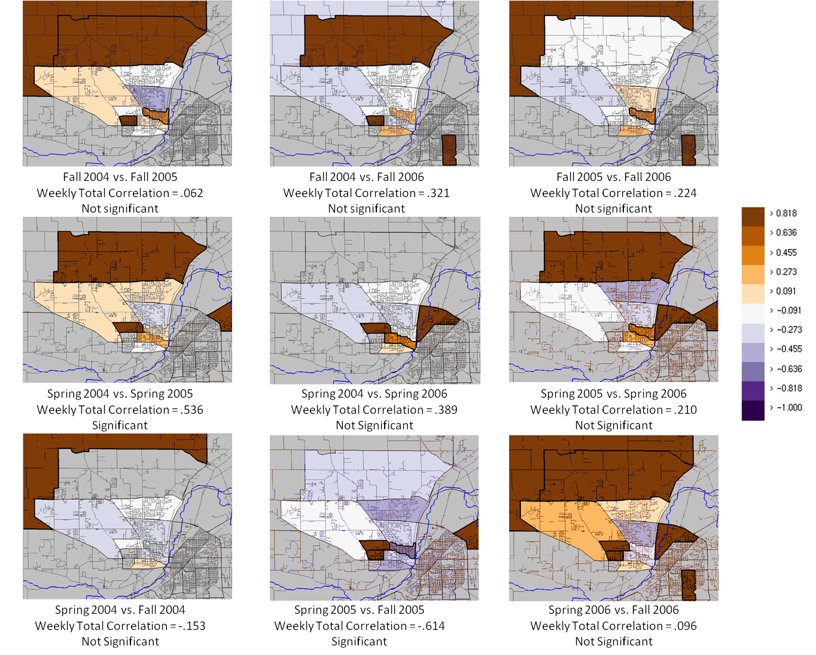
Abish Malik, Ross Maciejewski, Erin Hodgess and David S. Ebert. Describing Temporal Correlation Spatially in a Visual Analytics Environment. Hawaii International Conference on System Sciences, 2011.

Slide 38
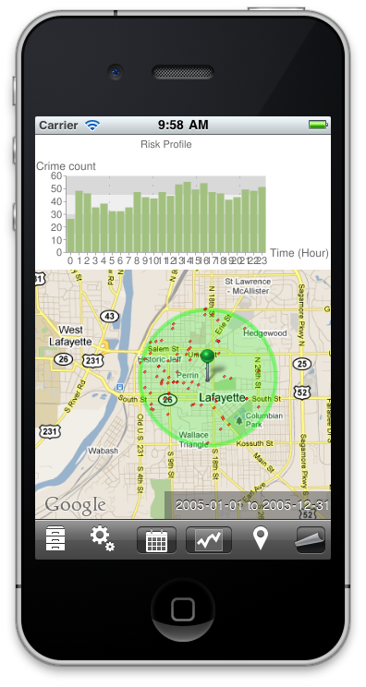
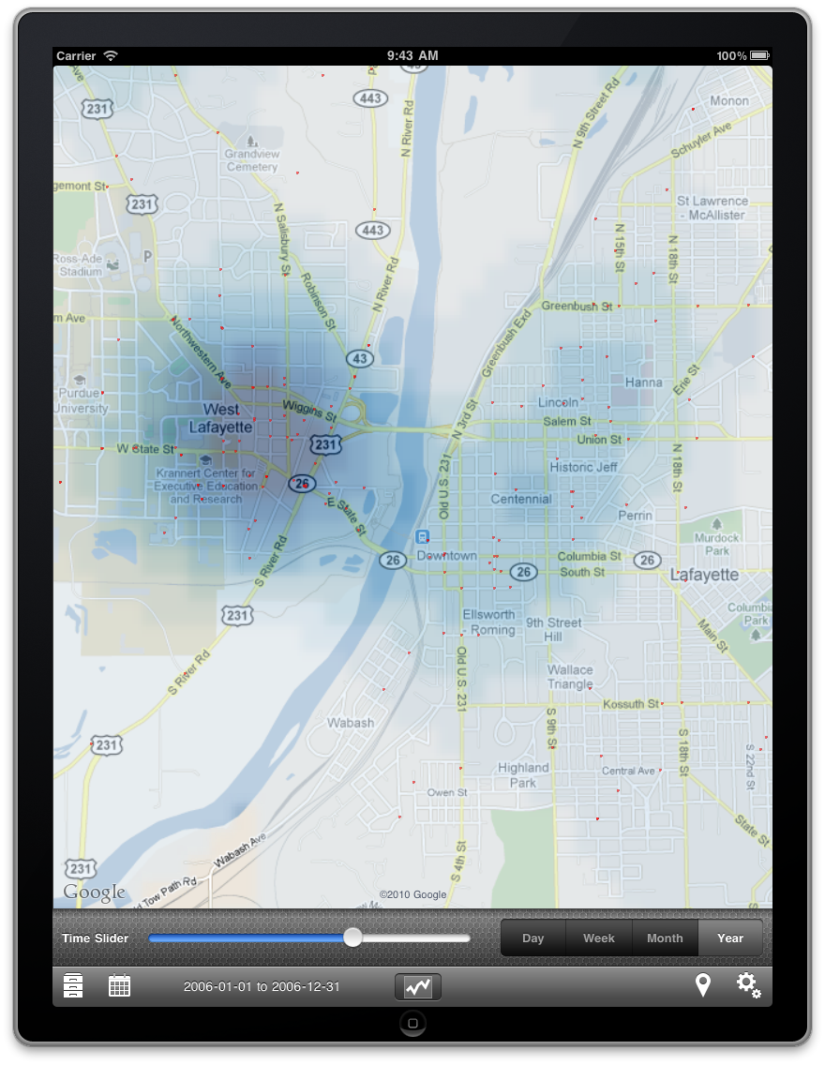

Slide 39
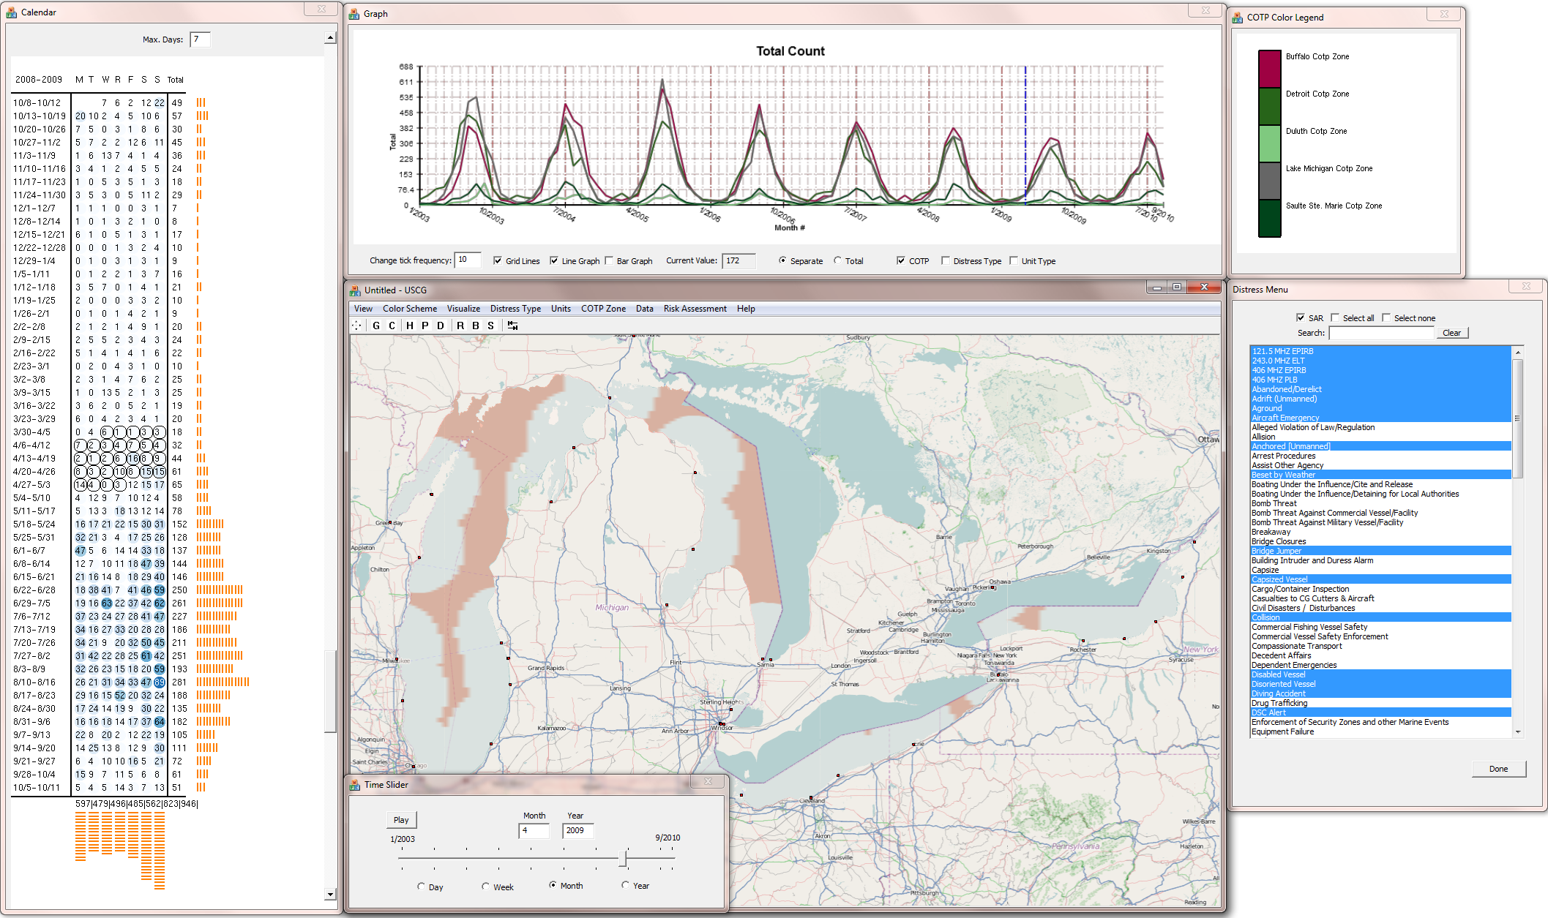
Coast Guard Search and Rescue Visual Analytics (CGSARVA)
Abish Malik, Ross Maciejewski, Ben Maule, David S. Ebert. A Visual Analytics Process for Maritime Resource Allocation and Risk Assessment. IEEE Conference on Visual Analytics Science and Technology (VAST), 2011.

Slide 40
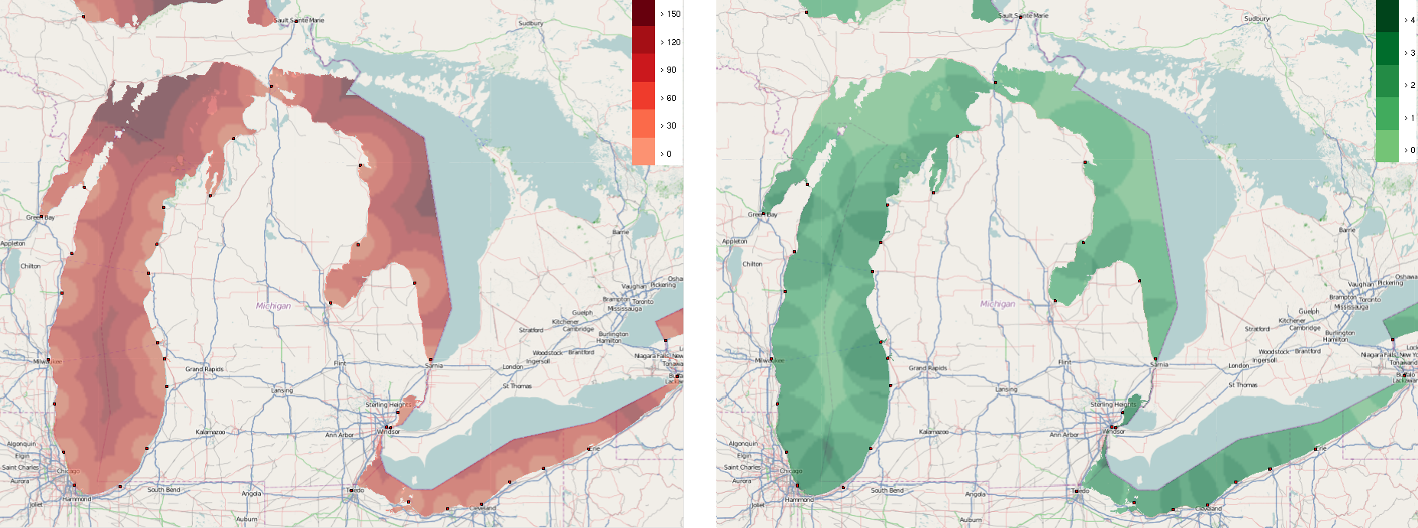
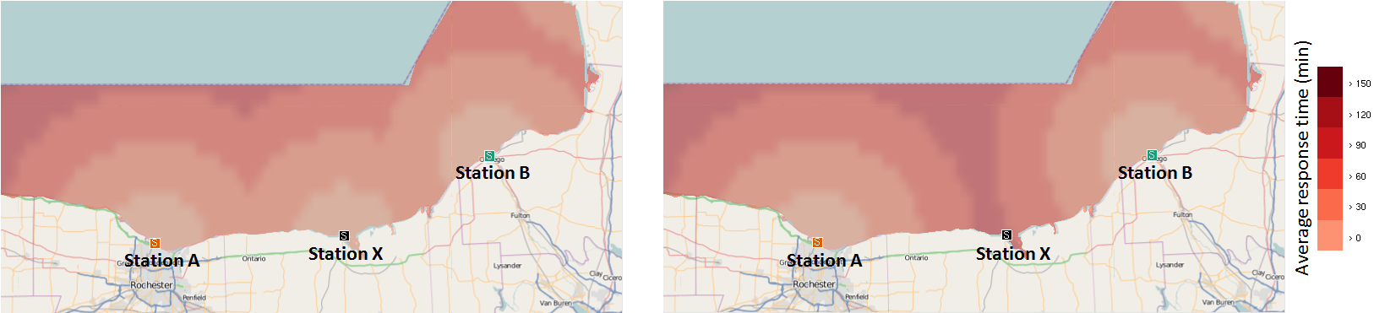
Assessing Risk in the Great Lakes
Risk profile. (Left) A heatmap showing the time taken (in minutes) by the Coast Guard stations to deploy an asset to the Great Lakes to respond to a SAR incident, assuming a speed of 15 nautical miles per hour. (Right) A heatmap showing the Coast Guard SAR coverage (i.e., the number of stations that respond to a particular region) in the Great Lakes. The squares along the coast show the locations of the stations.

Slide 41
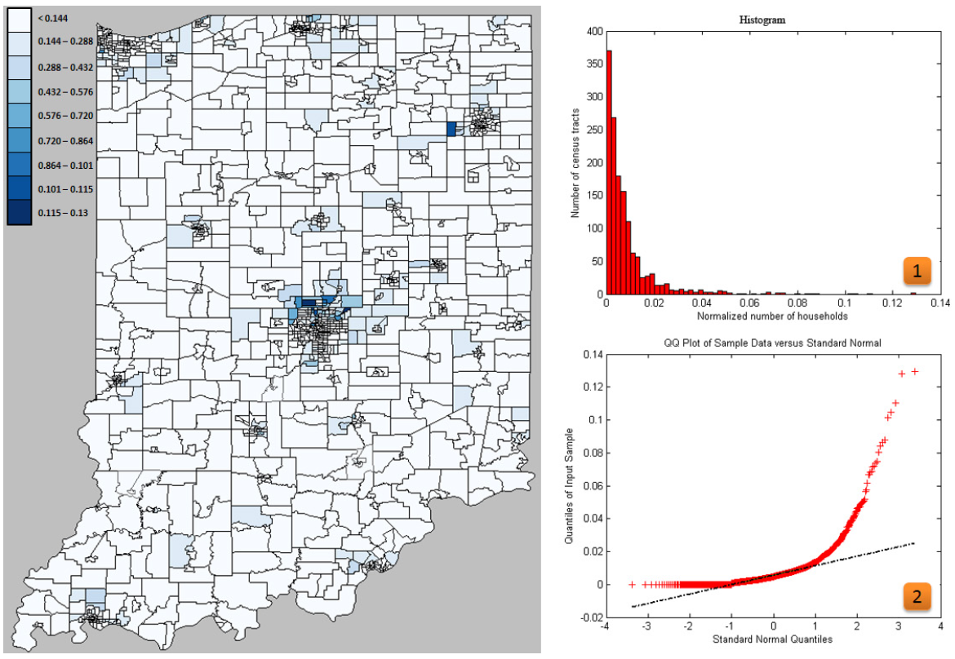
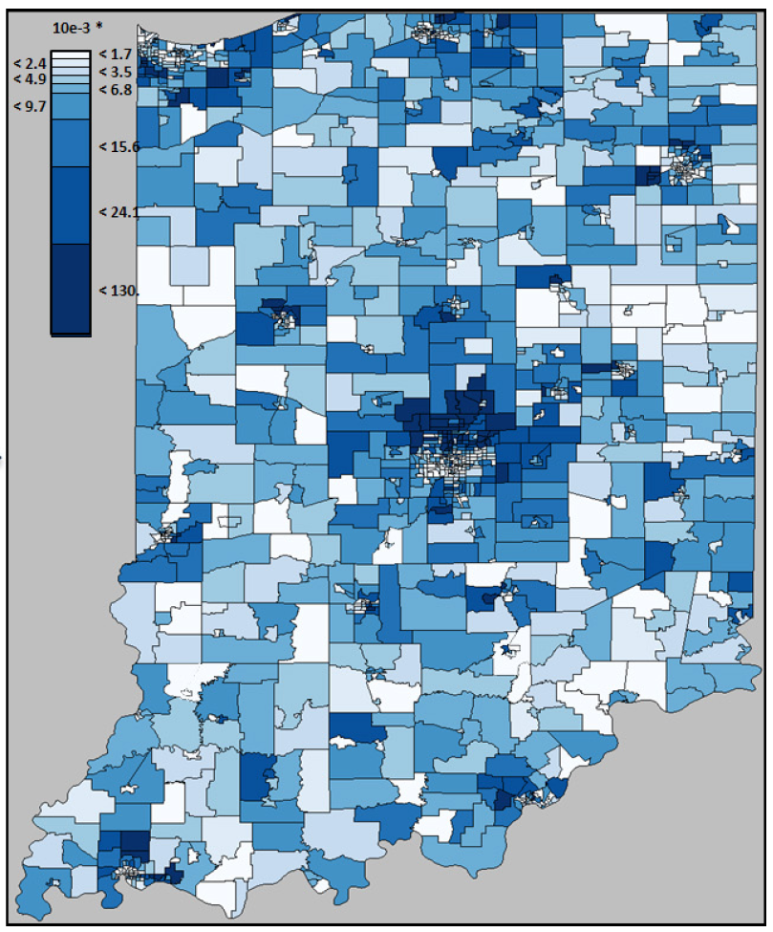
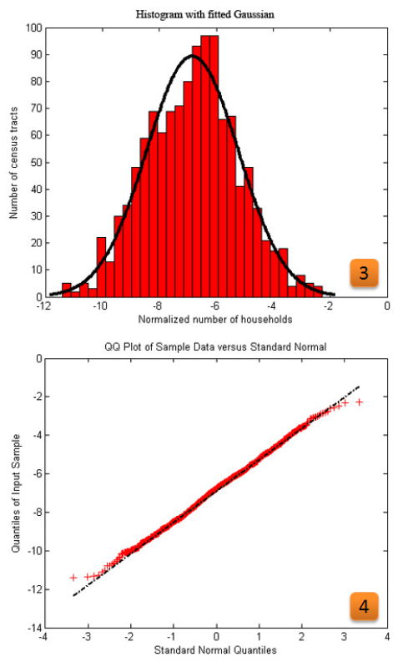
Power Transformations Revisited
41

Slide 42
Readings and Homework
Required Reading:
M. Jankowska, J. Aldstadt, A.Getis, J. Weeks, and G. Fraley, “An amoeba procedure for visualizing clusters,” in Proceedings of GIScience 2008, 2008.
Chen J, Roth RE, Naito AT, Lengerich EJ, Maceachren AM. Geovisual analytics to enhance spatial scan statistic interpretation: an analysis of U.S. cervical cancer mortality. International Journal of Health Geographics, 7:57, 2008.
Homework
Homework #3 is due in 9 days! (Feb 16th)
Milestone #2 is due in 16 days! (Feb 23rd)

